Slide 1

Humor detection in short English phrases using NLP
Final Report
Leyla Rocío Becerra Barajas
Joan Gabriel Bofill Barrera
Camilo Alfonso mosquera Benavides

Slide 2

AGENDA
Methodology
Models
Results
Conclusions
and
Future works

Slide 3


Methodology
Methodology
Random Forest
LSTM
BERT
Results
Conclusions
Classification Models
Results
Random Forest
Accuracy
Pre-processing data
LSTM Recurrent Neural Networks
Recall
Transformer Model: BERT

Slide 4




Tools
Methodology
Random Forest
LSTM
BERT
Results
Conclusions

Slide 5
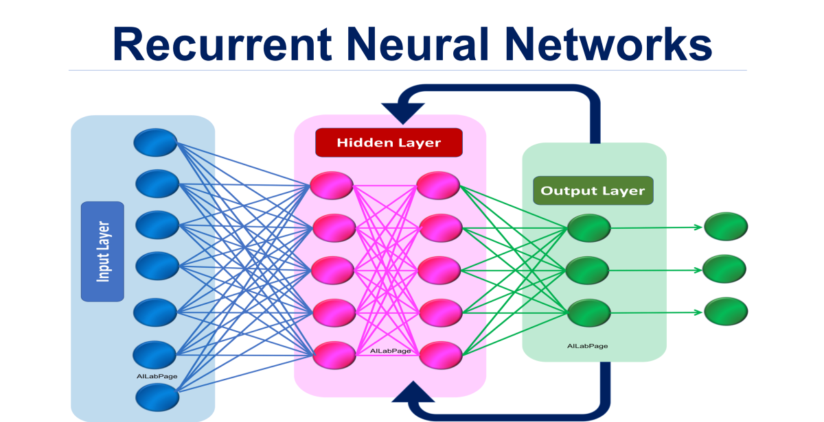
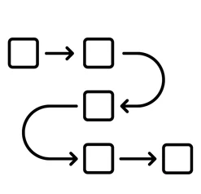
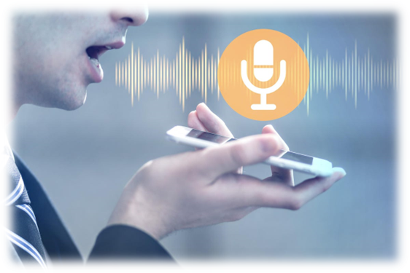


LSTM
Methodology
Random Forest
LSTM
BERT
Results
Conclusions
GloVe
Word2vec

Slide 6
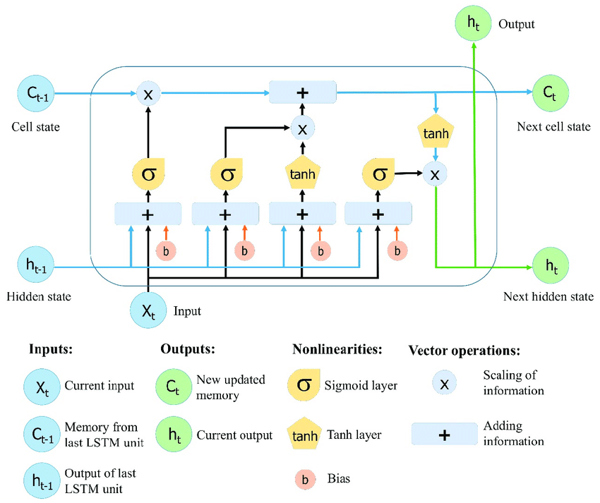
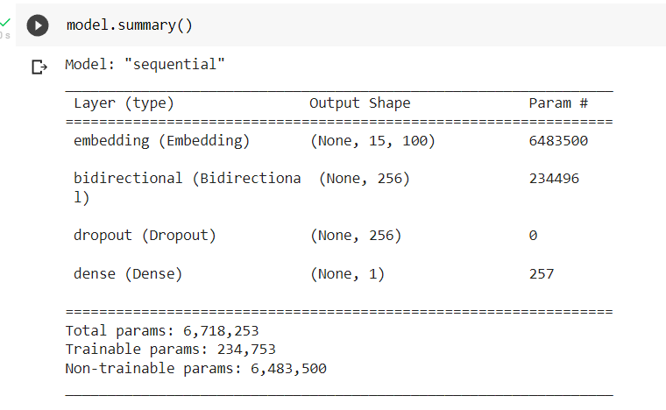

LSTM
Methodology
Random Forest
LSTM
BERT
Results
Conclusions

Slide 7
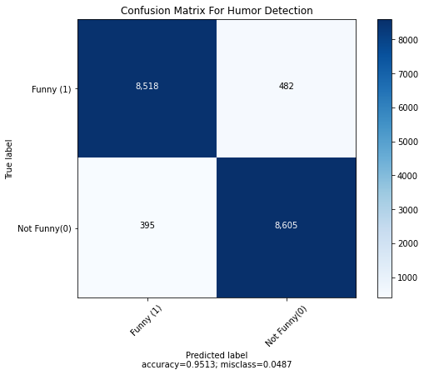
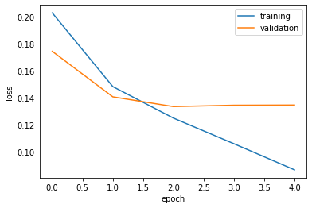

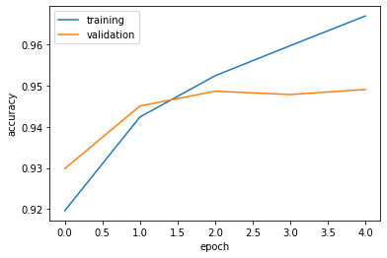


LSTM
Methodology
Random Forest
LSTM
BERT
Results
Conclusions
epochs
batch
15 min training

Slide 8
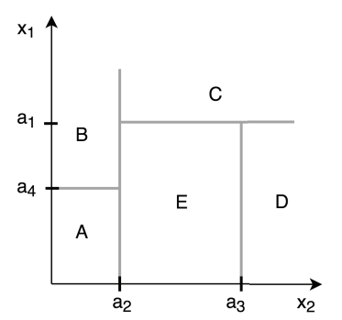

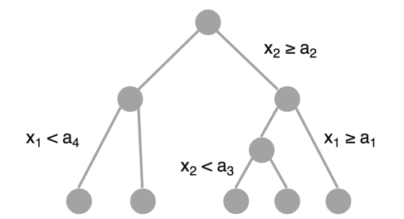
Random forest
Methodology
Random Forest
LSTM
BERT
Results
Conclusions
Decision tree

Slide 9
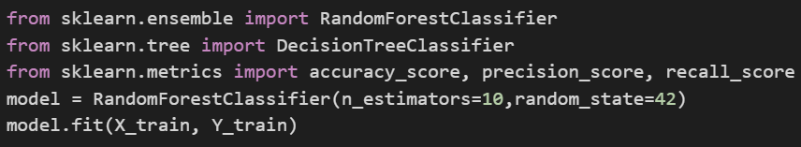
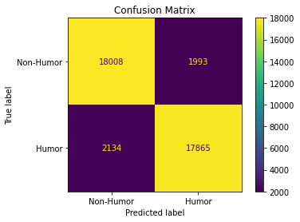

Random forest: Implementation
Methodology
Random Forest
LSTM
BERT
Results
Conclusions
Results
Accuracy 89.68%
Recall: 89.96%
10 min training

Slide 10

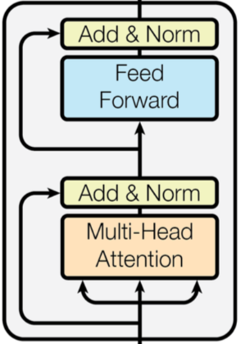
BERT (Bidirectional Encoder Representations from Transformers )
Methodology
Random Forest
LSTM
BERT
Results
Conclusions
Transformer architecture
BERT Large
Encoder 24
. . .
Decoder
BERT Base
Encoder 13
Encoder
Encoder 12
Encoder 12
. . .
. . .
Encoder 4
Encoder 4
Encoder 3
Encoder 3
Encoder
Encoder 2
Encoder 2
Encoder 1
Encoder 1
Image from VaswanI,2017

Slide 11


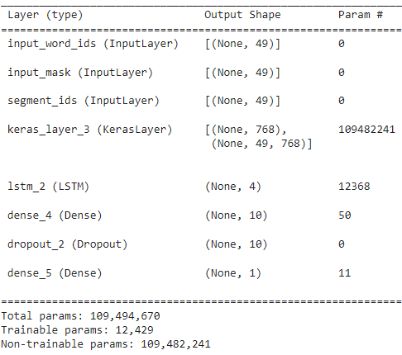
BERT: Implementation
Methodology
Random Forest
LSTM
BERT
Results
Conclusions
Output Sigmoid
Fine tuning
Feed forward Neural Network
LSTM Layer
BERT
Embedding
. . .
Implementation based in Lab 5 of Ramos R., 2021
<CLS>
W1
W2
W47

Slide 12
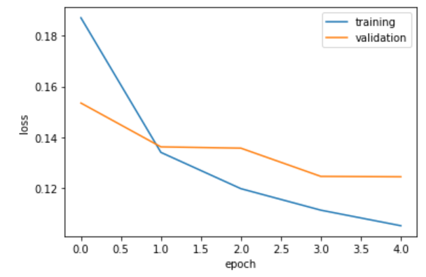
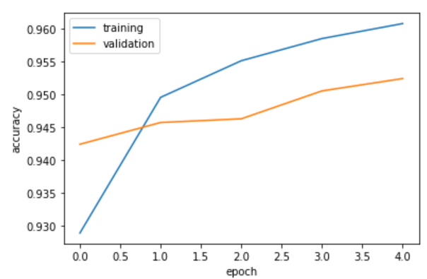
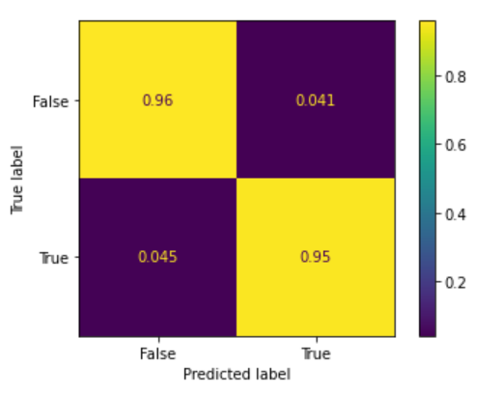

BERT: Results
Methodology
Random Forest
LSTM
BERT
Results
Conclusions
Confusion matrix
epochs
batch
35 min training

Slide 13
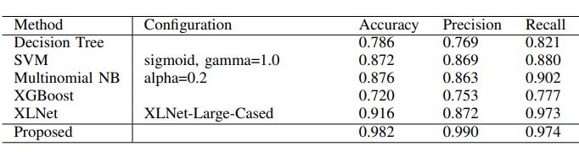
Results
Methodology
Random Forest
LSTM
BERT
Results
Conclusions
Model | Accuracy | Recall | Approx. Execution time (min)
Random Forest | 0.8968 | 0.8996 | 10
LSTM Recurrent neural networks | 0.9548 | 0.9567 | 15
BERT | 0.9567 | 0.9548 | 35
COMPARISON OF DIFFERENT METHODS ON THE COLBERT DATASET
Table from Annamoradnejad, 2021

Slide 14
CONCLUSIONS AND FUTURE WORK
Methodology
Random Forest
LSTM
BERT
Results
Conclusions
Best model proposed in balance between performance metrics and computational requirement is LSTM Recurrent Neural Networks
It’s important to continue testing some combination of layers in fine tuning with LSTM and Bert
There is a new model that represents a great opportunity to test and compare: ELECTRA or with classic models as SVM combined with some vector representation as Word2Vec.

Slide 15


Slide 16
References
Xinru Yan and Ted Pedersen. 2017. Who’s to say what’s funny? a computer using language models and deep
learning, that’s who! arXiv preprint arXiv:1705.10272.
B. Kitchenham, O. Pearl Brereton, D. Budgen, M. Turner, J. Bailey, and S. Linkman, “Systematic literature reviews in software engineering – A systematic literature review,” 2008, doi: 10.1016/j.infsof.2008.09.009.
“What makes us laugh? Investigations into Automatic Humor Classification - ACL Anthology.” https://aclanthology.org/W18-1101/ (accessed Apr. 17, 2022).
A. Jaiswal, M. Monika, A. Mathur, P. Prachi, and S. Mattu, “Automatic Humour Detection in Tweets using Soft Computing Paradigms,” Proc. Int. Conf. Mach. Learn. Big Data, Cloud Parallel Comput. Trends, Prespectives Prospect. Com. 2019, pp. 172–176, Feb. 2019, doi: 10.1109/COMITCON.2019.8862259.
G. G. Chowdhury, “Natural language processing,” Annu. Rev. Inf. Sci. Technol., vol. 37, pp. 51–89, 2003, Accessed: Apr. 17, 2022. [Online]. Available: http://eprints.cdlr.strath.ac.uk/2611/.
R. Mihalcea and C. Strapparava, “Making Computers Laugh: Investigations in Automatic Humor Recognition,” Accessed: Apr. 17, 2022. [Online]. Available: http://www.mutedfaith.com/funny/life.htm.
M. K. Hasan et al., “UR-FUNNY: A Multimodal Language Dataset for Understanding Humor,” EMNLP-IJCNLP 2019 - 2019 Conf. Empir. Methods Nat. Lang. Process. 9th Int. Jt. Conf. Nat. Lang. Process. Proc. Conf., pp. 2046–2056, 2019, doi: 10.18653/V1/D19-1211.
Devlin, J., Chang, M. W., Lee, K., Toutanova, K. (2018). Bert: Pre-training of deep bidirectional transformers for language understanding. arXiv preprint arXiv:1810.04805.
I. Annamoradnejad and G. Zoghi, “ColBERT: Using BERT Sentence Embedding for Humor Detection,” Apr. 2020, Accessed: Apr. 17, 2022. [Online]. Available: http://arxiv.org/abs/2004.12765.
Schonlau M, Zou RY., The random forest algorithm for statistical learning. The Stata Journal.
F. Shatnawi, M. Abdullah, and M. Hammad, “MLEngineer at SemEval-2020 Task 7: BERT-Flair based Humor Detection Model (BFHumor),” 14th Int. Work. Semant. Eval. SemEval 2020 - co-located 28th Int. Conf. Comput. Linguist. COLING 2020, Proc., pp. 1041–1048, 2020, doi: 10.18653/V1/2020.SEMEVAL-1.136.
Weller, O., Seppi, K. (2019). Humor detection: A transformer gets the last laugh. arXiv preprint arXiv:1909.00252.
Komorowski, M., Marshall, D. C., Salciccioli, J. D., Crutain, Y. (2016). Exploratory data analysis. Secondary Analysis of Electronic Health Records, 185–203.
A Basic Guide to Initial and Exploratory Data Analysis | by Kovid Rathee | Towards Data Science. (n.d.). Retrieved May 20, 2022, from https://towardsdatascience.com/a-basic-guide-to-initial-and-exploratory-data-analysis-6d2577dfc242
Michael I. Jordan. Serial order: A parallel distributed processing approach. Technical Report 8604, Institute for Cognitive Science, University of California, San Diego, 1986.
Hochreiter, S., & Schmidhuber, J. (1997). Long short-term memory. Neural computation, 9(8), 1735-1780.
Greff, Klaus, et al. "LSTM: A search space odyssey." IEEE transactions on neural networks and learning systems 28.10 (2016): 2222-2232.
Kyunghyun Cho, Bart van Merrienboer, Caglar Gulcehre, Fethi Bougares, Holger Schwenk, and Yoshua Bengio. Learning Phrase Representations using RNN EncoderDecoder for Statistical Machine Translation. arXiv preprint arXiv:1406.1078, 2014. URL http://arxiv.org/abs/1406.1078.
Seltman, H. J. (2018). Experimental Design and Analysis. Chapter 4: Exploratory Data Analysis
Vaswani, A., Brain, G., Shazeer, N., Parmar, N., Uszkoreit, J., Jones, L., Gomez, A. N., Kaiser, Ł.,Polosukhin, I. (n.d.). Attention Is All You Need.
Ramos, R., Arias, J., Fundamentos de Deep Learning, Universidad de Antioquia. https://rramosp.github.io/2021.deeplearning/intro.html. Accessed on 22/06/2022
.

